Slide 1

LAMASUS + BrightSpace
model comparison
Tamas Krisztin (IIASA), Michael Wögerer (IIASA), Ipsita Kumar (IIASA)

Slide 2
How to identify model outliers
Outlier across dimensions of:
Variable
Item
Region
Checking if either:
value is significantly different from the others, or
Trend is different than the one from the others
FAO values for observed period (pre 2020) are significantly different
AgLink trend for projections (past 2020) is different

Slide 3
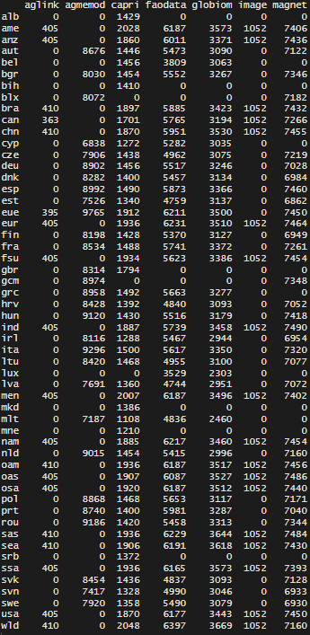
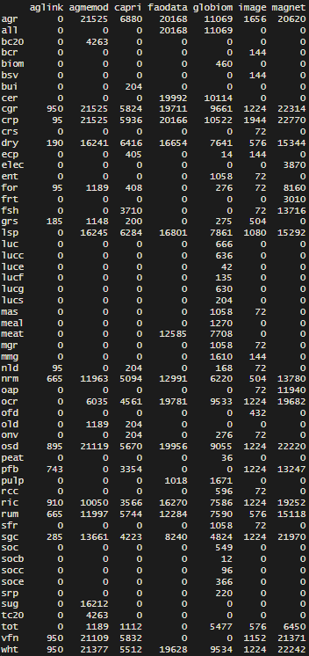
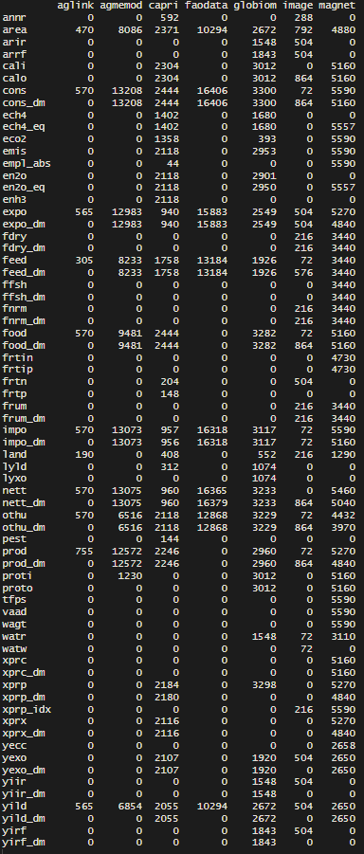
# of regional observations per model
# of variable observations per model
# of item observations per model

Slide 4
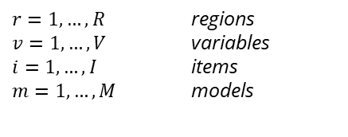
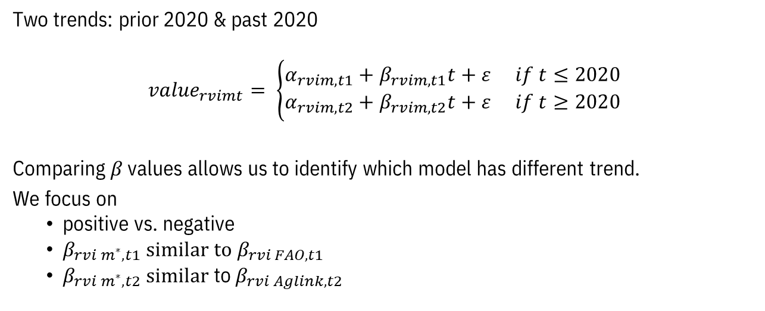
How trends are calculated
Two trends: prior 2020 & past 2020
$${value}_{rvimt}= \left\{\begin{aligned}{α_{rvim,t1}+β}_{rvim,t1}t+ε if t≤2020 \\ {α_{rvim,t2}+β}_{rvim,t2}t+ε if t≥2020\end{aligned}\right.$$
Comparing $β$ values allows us to identify which model has different trend.
We focus on
positive vs. negative
$β_{rvi m^{∗},t1}$ $similar to β_{rvi FAO,t1}$
$β_{rvi m^{∗},t2} similar$ to $β_{rvi Aglink,t2}$
$r=1,…, R$ regions $v=1,…,V$ variables $i=1,…,I$ items
$m=1,…, M$ models

Slide 5
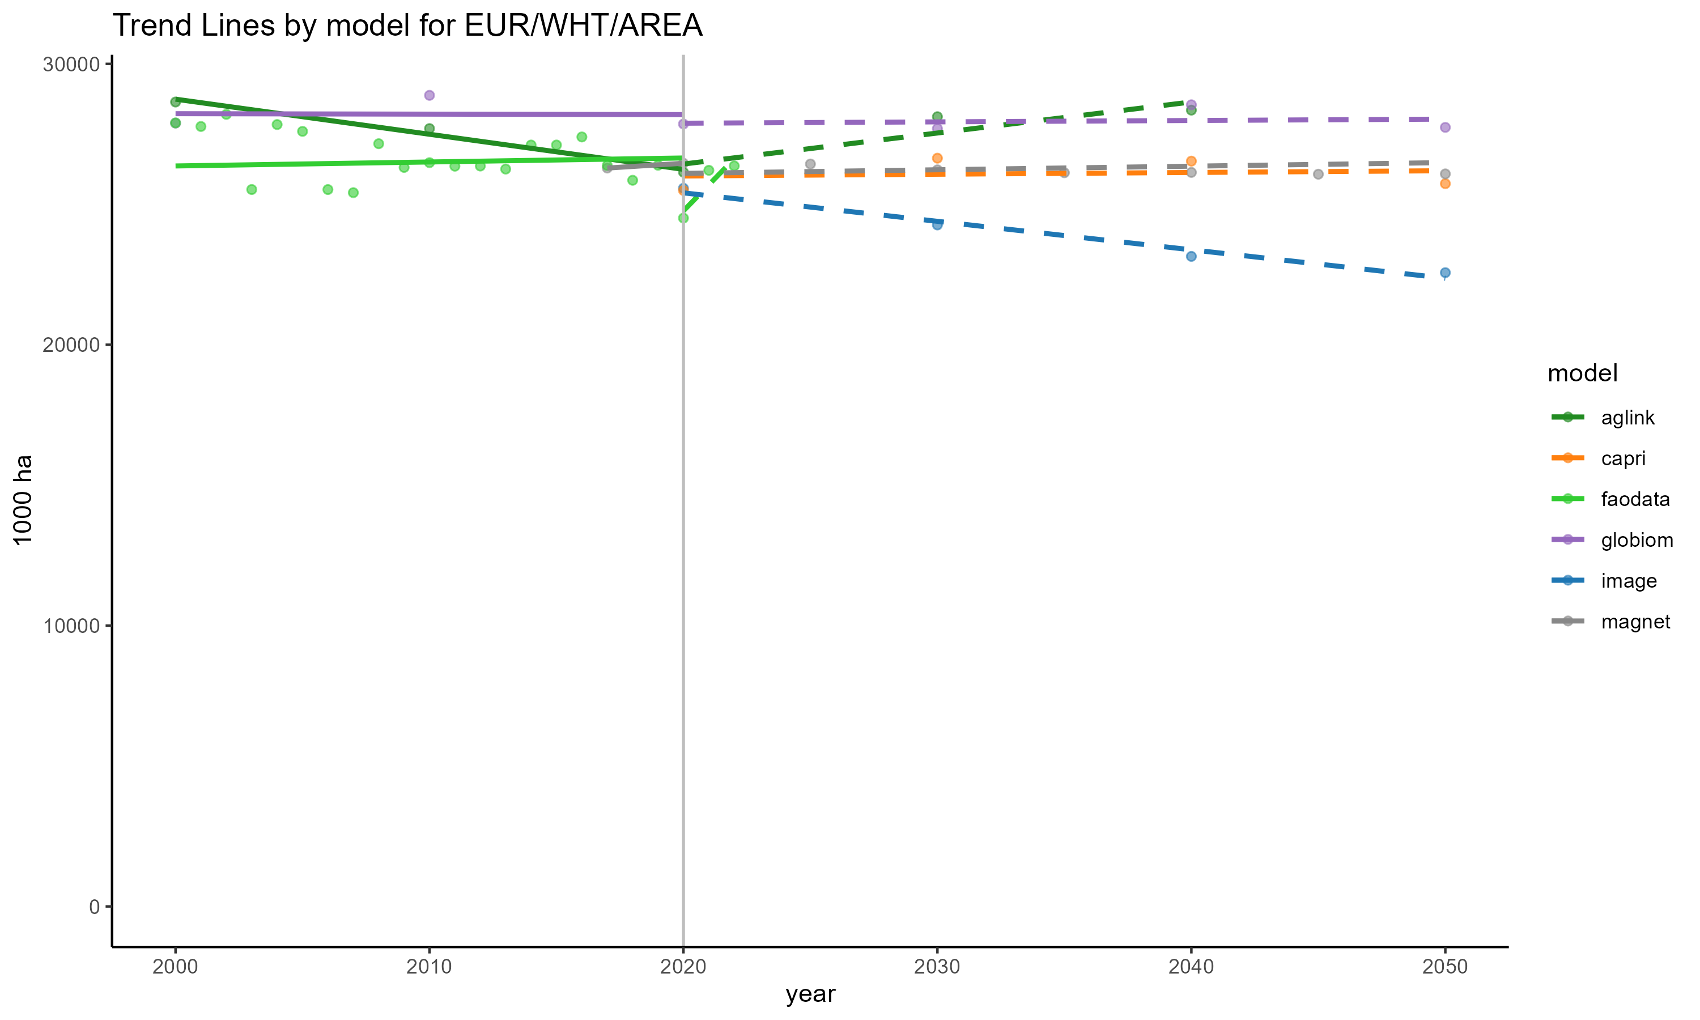
Example for EUR/WHT/AREA
Identified EUR/WHT/AREA as a problematic case:
Past 2020:
AgLink expects positive trend
GLOBIOM, CAPRI & MAGNET expect stable trend
IMAGE expects negative trend

Slide 6
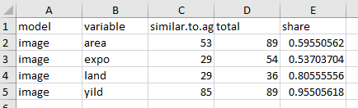
Comparison past 2020 (AgLink)
General comparison
Model | Similar trends (AgLink) | Comparable trends | Share
aglink | 1140 | 1140 | 1
agmemod | 28 | 50 | 0.56
capri | 802 | 1103 | 0.727
faodata | 464 | 773 | 0.6
globiom | 830 | 1105 | 0.751
image | 196 | 268 | 0.731
magnet | 806 | 1098 | 0.734
Detailed comparison per (variable/region/item) in excel

Slide 7
Outlook
Example graphs for all cases where outliers were identified
Model Specific excels to compare to AgLink
Same for before 2020 with FAO comparison
Cross-comparison (one model has different trend then others independent of AgLink)
Presentation, excels sent out hopefully later today, surely before Sevilla

Slide 8
Thanks for your attention!
Any Questions?

